Slide 1

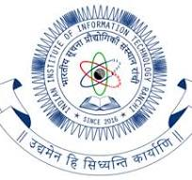
Environmental Science & Green Technology
Dr. NOOPUR
Assistant Professor
Deptt Of Humanities Social Sciences and Management
IIIT RANCHI

Slide 2
Lecture Objectives
Introduce the concept of water quality monitoring
Outline the criteria of water quality
Familiarise water quality monitoring in India
Discuss the process of water treatment

Slide 3
Water Quality Monitoring
Pollution degrades the quality of water available in fresh water resources
Threat for human life and aquatic life
Water pollution is mainly due to mismanagement of domestic, industrial and agricultural waste
Necessary action should be taken by the governing bodies of a country for the proper disposal and treatment of these wastes
Water quality parameters should be defined and the water samples of different waterbodies of a region should be analysed periodically
Keeping track of the quality of water in terms of predefined parameters is called water quality monitoring

Slide 4
Objectives of WQM
WQM helps to
Assess nature and extent of pollution control needed in different water bodies or their part
Evaluate effectiveness of pollution control measures already in existence
Evaluate water quality trend over a period of time
Assess assimilative capacity of a water body thereby reducing cost on pollution control
Understand the environmental fate of different pollutants
Assess the fitness of water for different uses
Rational planning of pollution control strategies and their prioritization

Slide 5
Key indicators of water quality
Dissolved Oxygen – Amount of oxygen in water expressed as mg/litre that is used by aquatic creatures
As mentioned earlier should not fall below 6mg/litre
Biochemical Oxygen Demand – The amount of dissolved oxygen required by aerobic bacteria to decompose the organic waste present in water, high value indicates presence of more organic waste
PH – If water is too acidic, threat for aquatic life, can affect respiration, photosynthesis and reproduction
Coliform bacteria – should not be too high
https://www.youtube.com/watch?v=MmeFcCFvKEU
https://www.youtube.com/watch?v=Rf7ByPaUmuM

Slide 6
Water Quality Criteria
Designated-Best-Use | Class of water | Criteria
Drinking Water Source without conventional treatment but after disinfection | A | Total Coliforms Organism MPN/100ml shall be 50 or less pH between 6.5 and 8.5 Dissolved Oxygen 6mg/l or more Biochemical Oxygen Demand 5 days 20°C 2mg/l or less
Outdoor bathing (Organised) | B | Total Coliforms Organism MPN/100ml shall be 500 or less pH between 6.5 and 8.5 Dissolved Oxygen 5mg/l or more Biochemical Oxygen Demand 5 days 20°C 3mg/l or less
Drinking water source after conventional treatment and disinfection | C | Total Coliforms Organism MPN/100ml shall be 5000 or less pH between 6 to 9 Dissolved Oxygen 4mg/l or more Biochemical Oxygen Demand 5 days 20°C 3mg/l or less
MPN – most probable number

Slide 7
Water Quality Criteria
Designated-Best-Use | Class of water | Criteria
Propagation of Wild life and Fisheries | D | pH between 6.5 to 8.5 Dissolved Oxygen 4mg/l or more Free Ammonia (as N) 1.2 mg/l or less
Irrigation, Industrial Cooling, Controlled Waste disposal | E | pH between 6.0 to 8.5 Electrical Conductivity at 25°C micro mhos/cm Max.2250 Sodium absorption Ratio Max. 26 Boron Max. 2mg/l

Slide 8
WQM in India
The water quality management in India is performed under the provision of Water (Prevention and Control of Pollution) Act, 1974. The basic objective of this Act is to maintain and restore the wholesomeness of national aquatic resources by prevention and control of pollution.
The act prescribes various functions for the Central Pollution Control Board (CPCB) at the apex level and State Pollution Control Boards at the state level.
The Act does not define the level of wholesomeness to be maintained or restored in different water bodies of the country. The Central Pollution Control Board (CPCB) has tried to define the wholesomeness in terms of protection of human uses, and thus, taken human uses of water as base for identification of water quality objectives for different water bodies in the country.

Slide 9
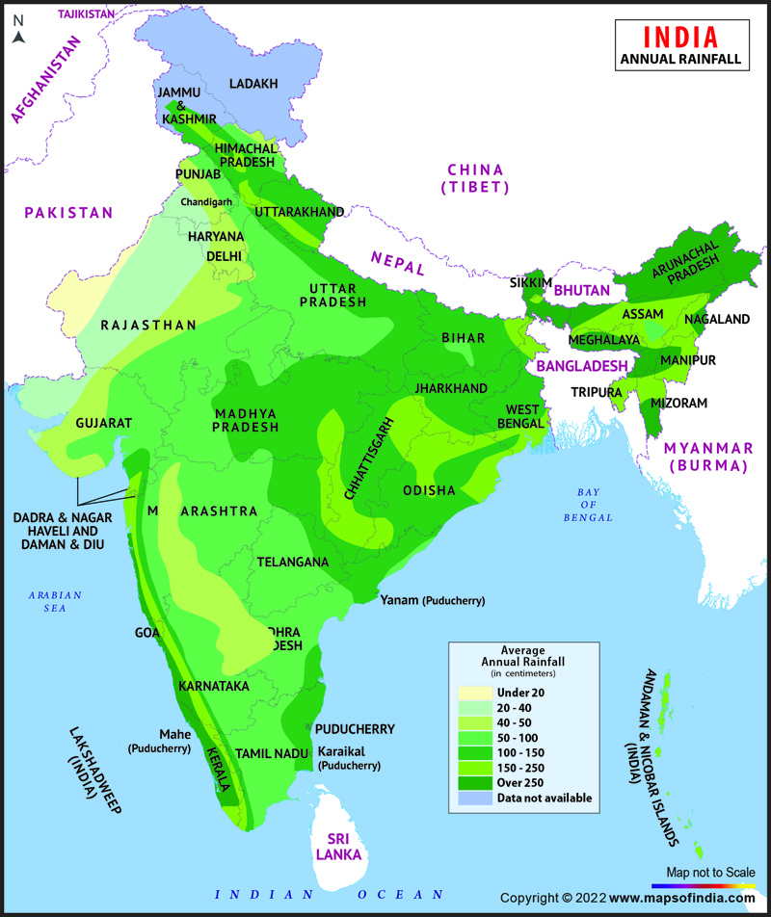
Fresh water availability in India
Only a small fraction is fresh water
India is wettest country in the world, but rainfall is highly
uneven with time and space
On an average there are only 40 rainy days
Water resources are over‐exploited resulting in WQ problems

Slide 10
Need for WQM in India
Domestic: 423 class I cities and 499 class II towns harboring population of 20 Crore generate about 26254
mld of wastewater of which only 6955 mld is treated.
Industrial: About 57,000 polluting industries in India generate about 13,468 mld of wastewater out of which
nearly 60% (generated from large & medium industries) is treated.
Non‐point sources also contribute significant pollution loads mainly in rainy season. Pesticides consumption
is about 1,00,000 tons/year of which AP, Haryana, Punjab, TN, WB, Gujarat, UP and Maharashtra are
principal consumers.
Domestic sewage is the major source of pollution in India in surface water which contribute pathogens, the
main source of water borne diseases along with depletion of oxygen in water bodies.

Slide 11
WQM Scheme in India
CPCB in collaboration with concerned SPCBs/PCCs established a nationwide network of water quality monitoring comprising 4484 stations in 28 States and 7 Union Territories.
The monitoring is done on monthly or quarterly basis in surface waters and on half yearly basis in case of ground water.
The monitoring network covers 719 Rivers, 348 Lakes, 134 Tanks, 107 Ponds, 102 Creeks/Seawater, 36 Canals, 81 Drains, 23 wetlands, 11 Water Treatment Plants (Raw Water) and 1235 Wells
Among 4484 stations, 2108 are on rivers, 437 on lakes, 110 on drains, 64 on canals, 141 on tanks, 194 on beach/creeks/marine/seawater, 112 on ponds, 49 on Sewage Treatment Plants, 11 on Water Treatment Plants (Raw Water), 23 on Wetlands and 1235 are Groundwater stations.
https://cpcb.nic.in/uploads/WQM_Objective.pdf

Slide 12
Steps involved in WQM
WQM is implemented in three steps
Physical tests – done at the site ( stations already identified and listed)
Indicate properties detectable by our senses
2. Chemical tests – done at certified chemical laboratories by taking water samples from the site
To determine the amount of organic and inorganic substances that affect water quality
3. Bacteriological Tests – done at the certified microbiological laboratories if necessary
To check the presence of bacteria and characteristics of faecal pollution

Slide 13
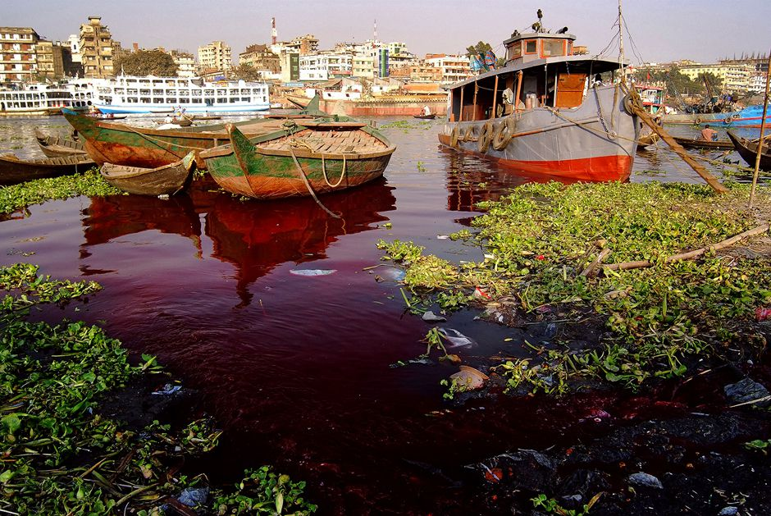
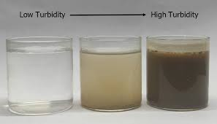
Physical Tests
Physical test involve the following parameters
Colour : pure water is colourless. Colour indicates presence of some organic or inorganic materials
Turbidity: measure of transparency .. Turbidity goes high due to suspended sediments and colloidal matter
Odour and taste : pure water is odourless and tasteless. Change of odour and taste is observed and noted.
Can be due to the presence of living microorganisms or due to decaying organic matter
Temperature: Dissolved Oxygen gets reduced
with increase in temperature, temperature change is
usually due to discharge of industrial waste water

Slide 14
Chemical Tests
Chemical Test includes
PH – Indication of hydrogen ion concentration. Should be between 6.5 – 8.5
DO – Dissolved Oxygen – low value indicates threat for aquatic life and hence the quality of water
BOD – Biochemical Oxygen Demand - high indicates need for improving the quality
KH – Carbonate Hardness, should be tested as it has a great impact on PH of water
Conductivity , TSS, TDS tests
TSS – Total Suspended Solids
TDS – Total Dissolved Solids
https://publiclab.org/notes/anngneal/12-08-2017/7-ways-to-measure-monitor-and-evaluate-water-quality

Slide 15
Bacteriological Tests
To verify the presence of excess number of coliform bacteria
Coliform can survive even at a temperature of 44 degree Celsius
The test procedure involves three steps
Presumptive test –to remove all microorganisms other than coliform
Confirmed test – if presumptive test is positive , additional step to confirm the presence of coliform
Completed test – to determine the amount of coliform present in the water sample
https://labmonk.com/bacteriological-analysis-of-water

Slide 16
Water Treatment Process
Can be classified into three
Primary Treatment –Disinfection – removal of pathogenic micro organisms
Examples : Chlorination, Ozone treatment, UV treatment and membrane filtration
Secondary Treatment
Involves sedimentation and filtration followed by disinfection
Complete Treatment
Coagulation
Flocculation
Sedimentation
Filtration
Disinfection

Slide 17
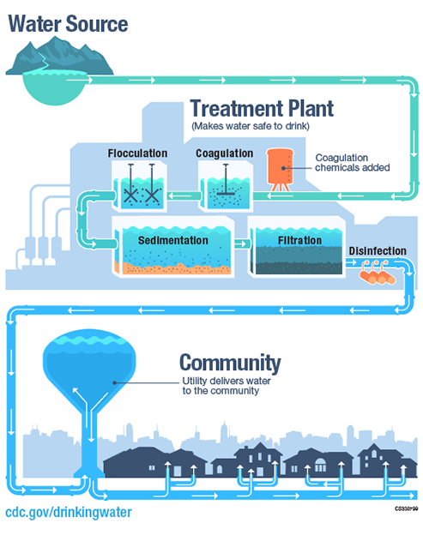
Complete treatment
Water used for drinking, cleaning fish and ice-making must
be free from pathogenic bacteria
Requires secondary treatment or even complete treatment
Depends on chemical elements that are to be removed

Slide 18
Preliminary Steps
Coagulation
Coagulation is adding liquid aluminum sulfate or alum and/or polymer to raw or untreated water. The resulting mixture causes the dirt particles in the water to coagulate or stick together. chemicals with a positive charge are added to the water. The positive charge neutralizes the negative charge of dirt and other dissolved particles in the water. When this occurs, the particles bind with the chemicals to form slightly larger particles.
Flocculation
The groups of dirt particles attach together, forming larger particles named flocs that can easily be removed via filtration or settling. water treatment plants will add additional chemicals during this step to help the flocs form. (Eg . Ferric Chloride)
Sedimentation
When water and flocs undergo the treatment process, they go into sedimentation basins. Here, water moves slowly, making the heavy floc particles settle to the bottom. Floc that accumulates on the bottom is known as sludge. This is carried on to drying lagoons. Direct Filtration does not include the sedimentation step and the floc is just removed by filtration.

Slide 19
Filtration
In filtration, water passes through a filter, which is made to take away particles from the water
Filters are composed of gravel and sand or sometimes crushed anthracite.
Filtration gathers together impurities that float on water and boosts the effectiveness of disinfection.
Commonly used Filter methods
SLOW SAND FILTER
RAPID SAND FILTER
Different types of filter paper
Micro -pore size of approximately 0.1 micron
Ultra -pore size of approximately 0.01 micron
Nano -pore size of approximately 0.001 micron
https://www.fao.org/3/x5624e/x5624e05.htm

Slide 20
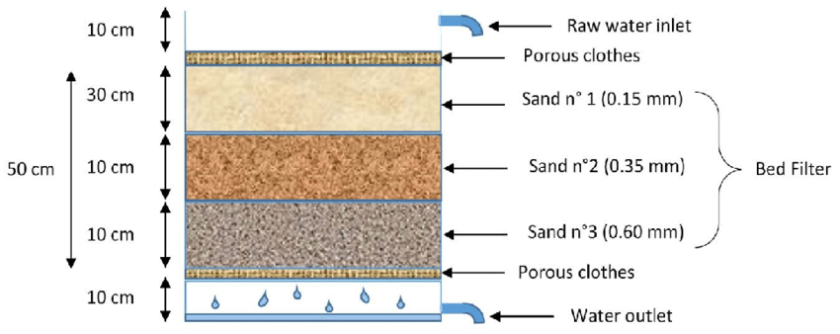
Slow Sand Filter

Slide 21
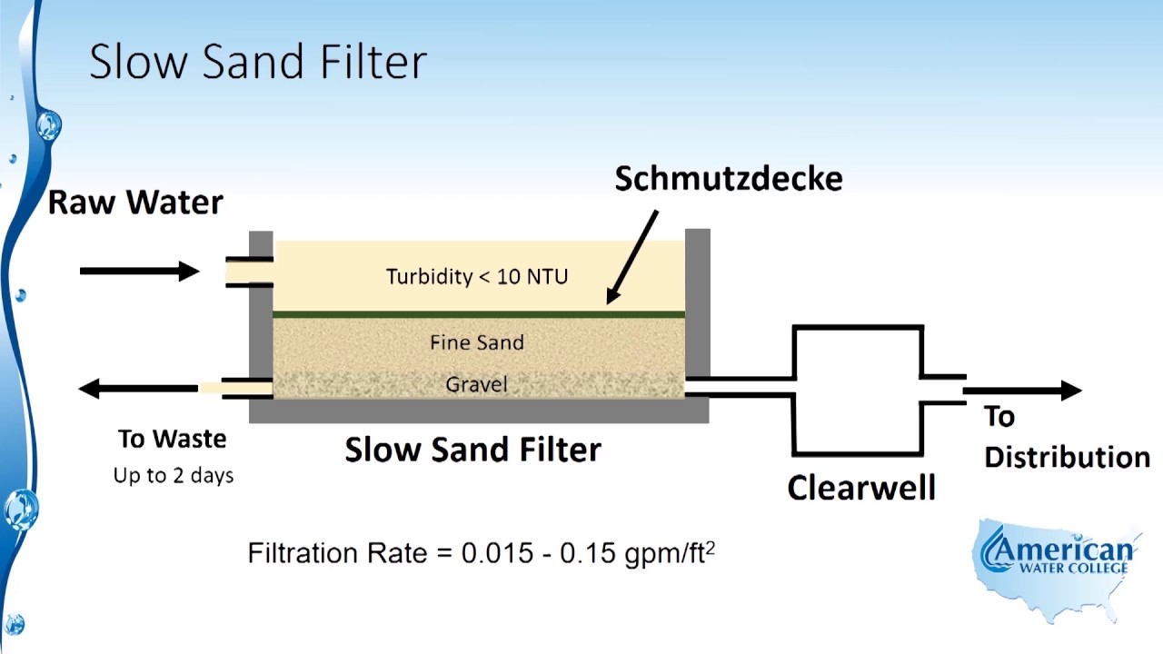
NTU -Nephelometric Turbidity unit

Slide 22
Slow Sand Filtration Process
Filtration is slow since it is a biological process
Raw water is passed slowly through the bed of sand filter
The outlet valve for clean water should be kept closed for 2-4 days
Within 2 -4 days, a thin bio film (Schmutzdecke) will be formed on the sand bed.
The raw water entered into the sand bed is removed through the waste outlet valve for 2-4 days
Once the biofilm is formed, raw water enters into the sand bed passes through this film and filters different types insoluble impurities /contaminants and certain microorganisms
Now clean water can be taken through the outlet valve.
Sand bed mainly acts a support to carry the biofilm

Slide 23
Merits and Demerits
Merits
Low cost
No skilled personnel is required for operation and monitoring
Efficiency is good ( 99%)
Demerits
2 -3 days of waiting for the formation of biofilm
Filtration process is slow ( less than 1 litre /hr) since it is a biological process
Filter tank volume should be huge or large space is required
Filter bed can be cleaned only by removing it from the tank. Time consuming process

Slide 24
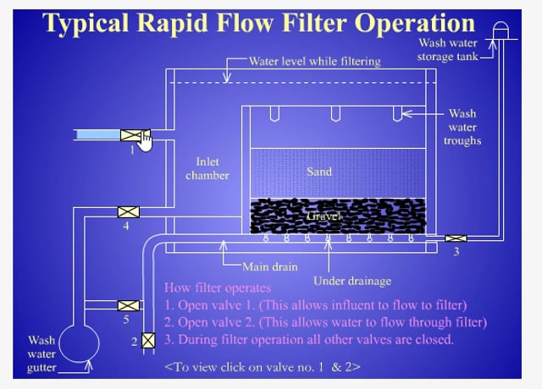
Rapid Sand Filter
Gravel bed of 60 – 90 cm
4 -5 layers of varying size
Bottom gravel size - 20mm – 40mm
Middle gravel size – 12mm- 20mm
Top gravel size – 6mm -12mm
Filtration rate is very high compared to slow sand
https://www.youtube.com/watch?v=mvG61BYwdGs

Slide 25
Working of rapid sand filter
Unlike slow sand filter, rapid sand filtration is mechanical.
Raw water enters into the sand bed and the different layers of sand bed will act as filter.
Impurities/ pollutant particles will remain in the sand bed layer according to their size.
Clean water will reach the bottom and a portion of it is stored in backwash storage tank.
The sand bed will be cleaned by pumping the backwash water through the piping arrangements at the bottom and backwash trough at the top.
Backwashing is 10 -15 times faster than raw water filtration.
During backwashing process, the raw water inlet and clean water outlets are kept closed,

Slide 26
Merits and demerits
Merits
High filtration rate (5 litre/hr)
Backwashing process helps to clean the filter bed quickly
Less space is required
Demerits
Expensive
Skilled personnel is required
Efficiency is less owing to the mechanical filtration process ( 97%)

Slide 27
Disinfection – popular methods
Chlorination
Ozonation
UV treatment
Reverse Osmosis
https://www.aquatechtrade.com/news/water-treatment/water-treatment-essential-guide/

Slide 28
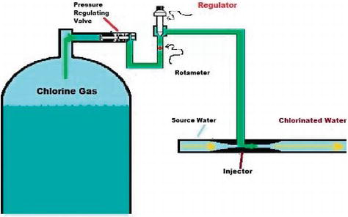
Chlorination
Adding chlorine into water to remove harmful microorganisms
Free chlorine or residual chlorine should be present in water
to maintain PH
Chlorine in gaseous form is the best choice but expensive
Solid Calcium hypochlorite is used for domestic purpose
CaOCl2
The issue is the storage of CaOCl2 in a safe place without
exposing to fire and heat
https://www.intechopen.com/chapters/63788

Slide 29
Merits and Demerits
Merits
Economical : cheaper than UV or Ozone
Dose can be controlled
Effective in removing pathogens
Residual chlorine in water ensures
Disinfection for a longer duration
Demerits
Difficulty in using gaseous or liquid chlorine for domestic purpose
Dry, cool well ventilated storage place is required for solid chlorine
Bad taste and smell are added to water due to chlorination
Partially oxidized compounds can be toxic
eg, Trihalomethane (THM), Chloro-organics
THMs in water should not exceed 0.1mg/l

Slide 30
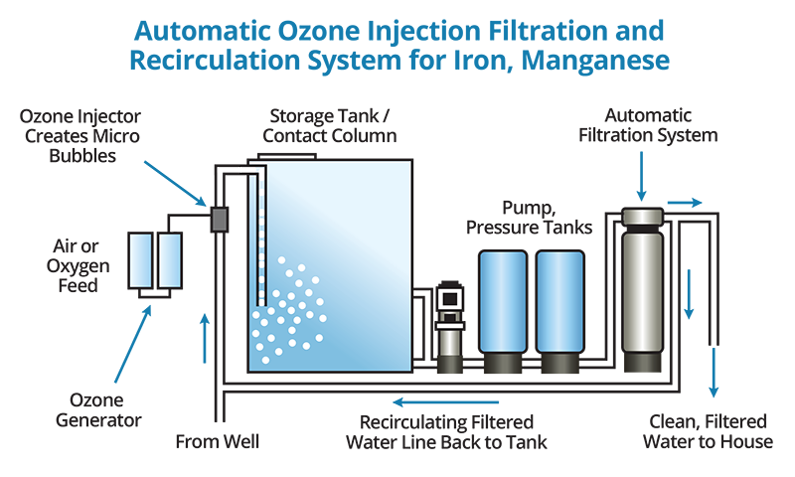
Ozone Treatment
Water is exposed to the free radical state
of Oxygen that is ozone
Oxidation potential of ozone is very high
Most popular water treatment method in
Europe for Municipal water treatment
Expensive but effective
Requires post filtration
https://www.youtube.com/watch?v=dB6Dxsxb8Og

Slide 31
Merits and Demerits
Merits
Demerits
On site preparation of ozone is mandatory
Special equipment and trained personnel is required
Toxic if concentration is high
Large amount of energy is required
Ozonation may cause corrosion to water carrying metal pipes
Water should be aerated before use
Chances of fire hazard
High oxidizing power and small reaction time
Highly effective in removing germs
Oxidizes iron and Manganese
Provides oxygen into water during the process
No change of colour or smell for disinfected water
No chemical is added into water
Removes, algae and organic matter

Slide 32
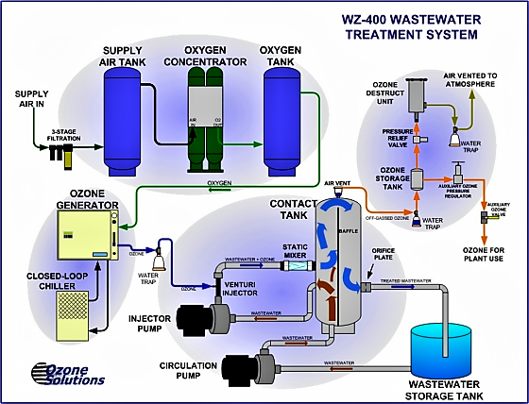
Waste Water Treatment using Ozone

Slide 33
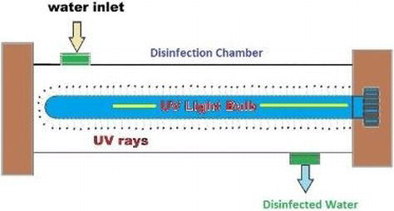
UV treatment
Can be used for treating waste water, drinking water or aquaculture
Water is exposed to UV rays
Disinfection is achieved by changing the DNA
structure of the microorganisms
https://www.youtube.com/watch?v=bK8trlXfcyA

Slide 34
Merits and Demerits
Merits
Demerits
Special equipment and trained personnel is required
Large amount of energy is required
Turbidity of water should be low for effectiveness
Periodical Cleaning is required
No Corrosion
No by products are formed
It limits the regrowth potential of microbe
No change of colour or smell for disinfected water
No chemical is added into water

Slide 35
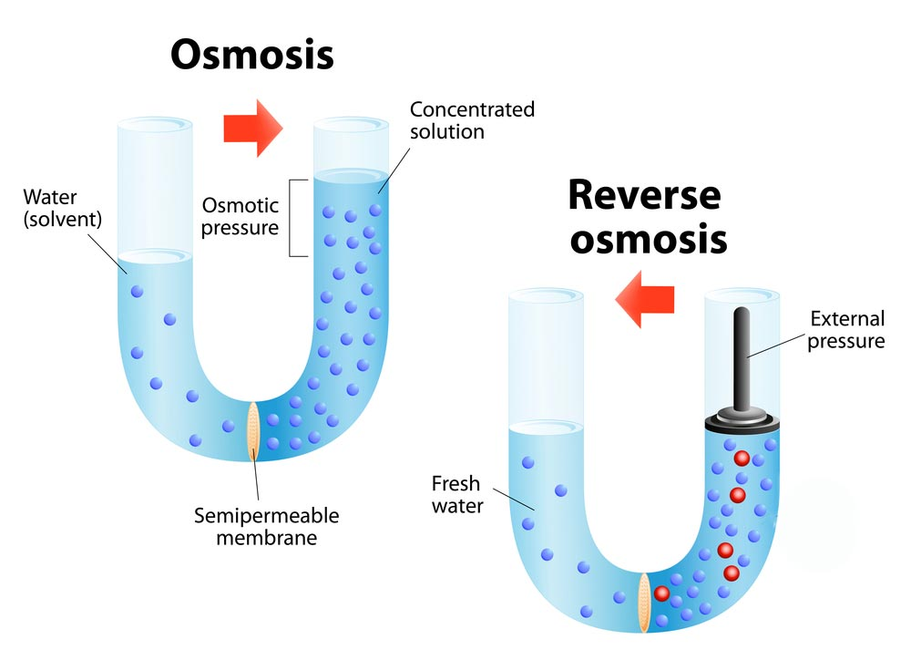
Reverse Osmosis
One of the most efficient purification method
Commonly used in modern domestic
and industrial applications
https://complete-water.com/resources/what-is-reverse-osmosis

Slide 36
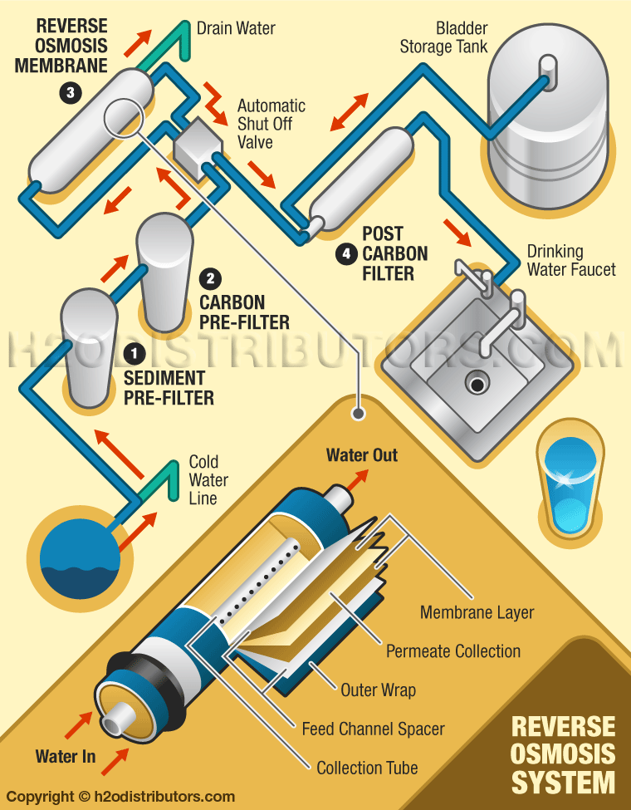
Working
https://www.youtube.com/watch?v=aVdWqbpbv_Y
https://www.youtube.com/watch?v=B7qB62Msems

Slide 37
Merits and Demerits
Merits
Demerits
Expensive system
Large amount of water is wasted
Most effective in killing pathogens and
removing contaminants if combined with UV
Safe and environmental friendly

Slide 38
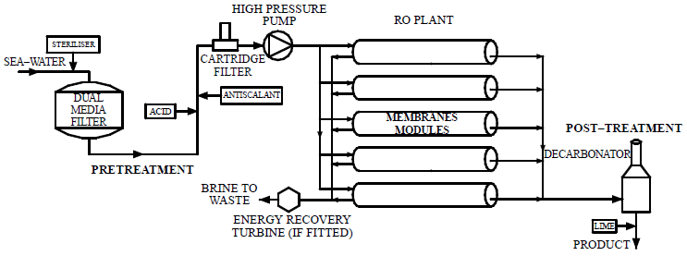
Seawater treatment

Slide 39
Disinfection and sterilization
Disinfection is the process of removing disease causing microbial lives from water
Disinfection kills only coliform bacteria or pathogenic microbe present in water
Disinfected water is used for drinking and cooking purpose
Sterilization removes all types of microorganisms present in water or any equipment
Sterile water is used for healthcare applications

Slide 40
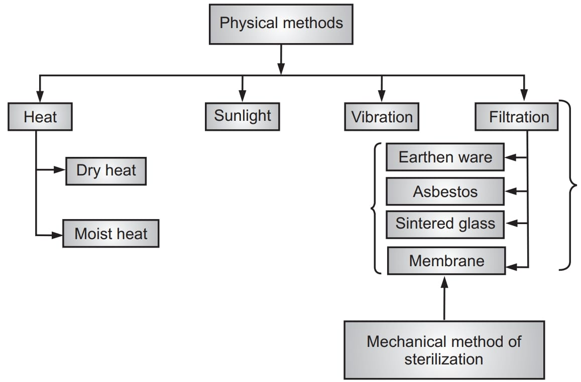
STERILIZATION METHODS
https://www.youtube.com/watch?v=Js18jEFbbs0

Slide 41
Chemical Methods of Sterilization
Hydrogen Peroxide
Nitrogen Dioxide
Ozonation
UV Radiation
Ethylene Oxide
https://www.sciencedirect.com/topics/medicine-and-dentistry/chemical-sterilisation

